Slide 1
UNION BUDGET ANALYSIS
(2023-2024)
- Aastha sawner

Slide 2
OBJECTIVE
The union budget is prepared by government for a fiscal year . Here I have taken the union budget to study for the year of 2023-2024 this dataset contains the fields like capital , revenue and the some total of budget estimation of different ministries and demands . Here the study is done by using visualization tool i.e power BI different charts is created for more attractive and clear visualization.
The union budget dataset helped to understand the capital and revenue generation of different departments of ministry like finance , railways and many more .

Slide 3
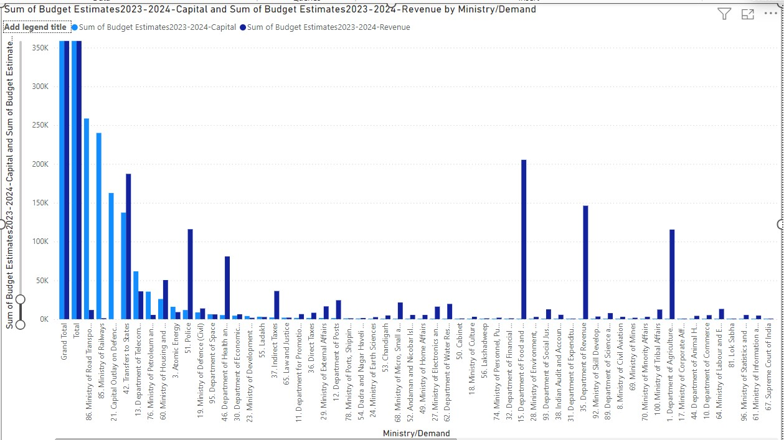
Sum of capital and revenue by ministry demand
--------------------------------------
The stacked column graph used to show the capital and revenue together in ministry/demand.
Here we can observe that the ministry of road and transportation capital is more as compare to there revenue .
The departments like police and health-care generates more revenue as per there capital.

Slide 4
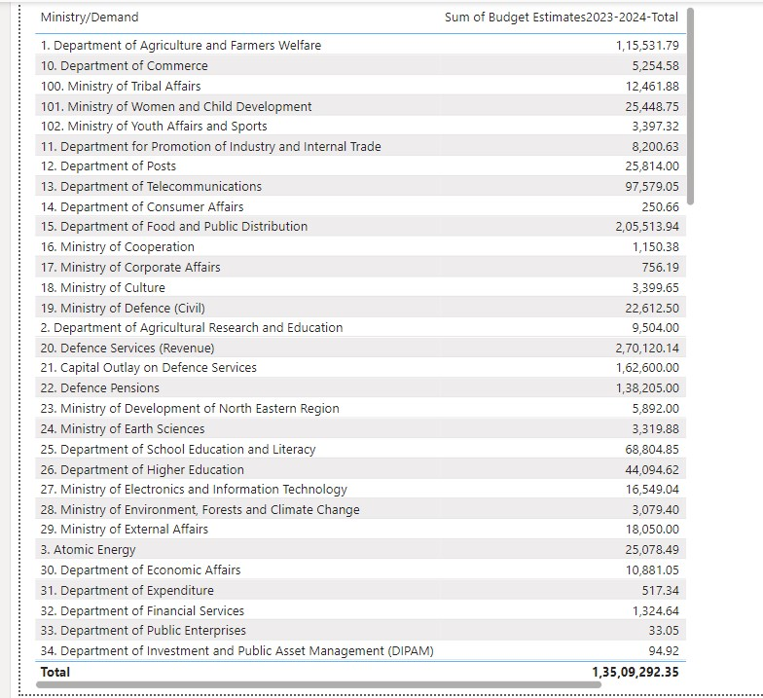
Budget comparison in ministry/demands ------------------------------
Here the table visualization is used to show the sum of budget in total as per ministry demands .
There are total of 56 departments and the higest record is from DEFANCE SERVICES.
The top three departments are defence services , food and public distributions , agriculture and farmers welfare .
The overall total sum of all ministries are 1,35,09,292.

Slide 5
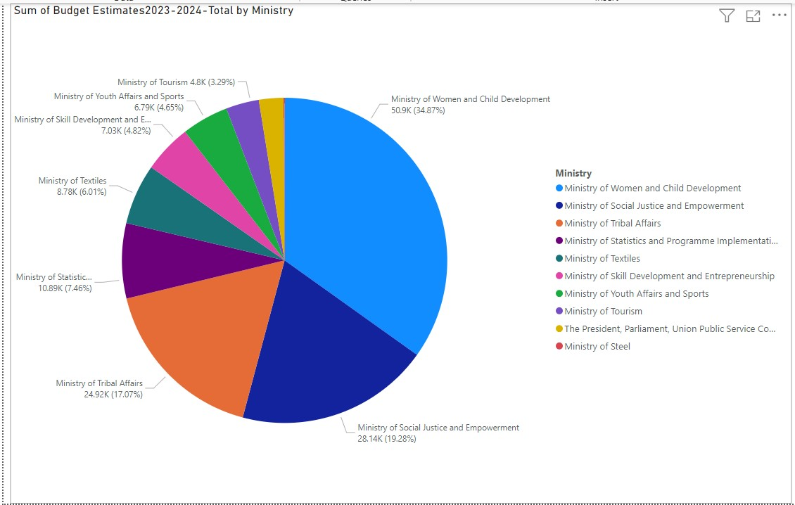
Ministry budget estimation as aggregates
-----------------------------------------
The pie chart is use to visualize each ministry contribution to total budget.
The approximately 38 % of total budget is from ministry of women and child development.
ministry of women and child development , ministry of social justice and empowerment and ministry of tribal affairs are the top three budget allocations.
Right hand side of the fraphs shown the legends to categories by different colours .

Slide 6
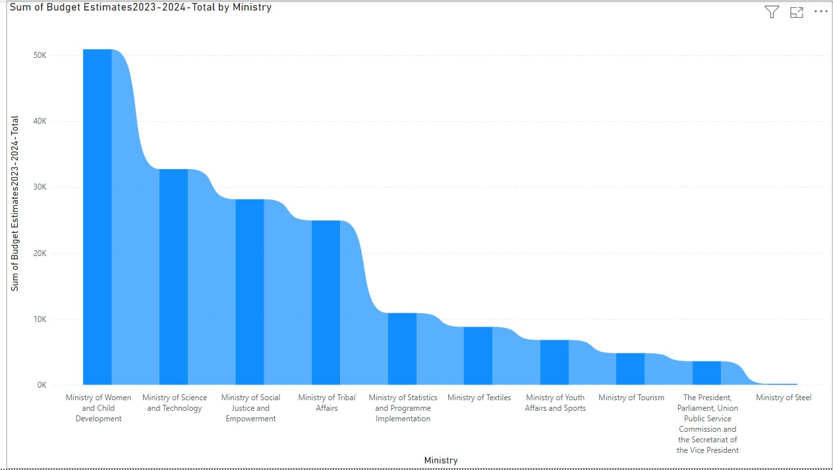
Budget distribution of departments in total
--------------------------------------------
Sum of budget estimation 2023-2024 total by ministry Is shown in this chart .
The x-axis shows the ministry lables same the y-axis shows the sum as per total budget.
The highest value to be taken is 50k and which is from women and child department .
Ministry of steel has the lowest total sum in ministry .

Slide 7
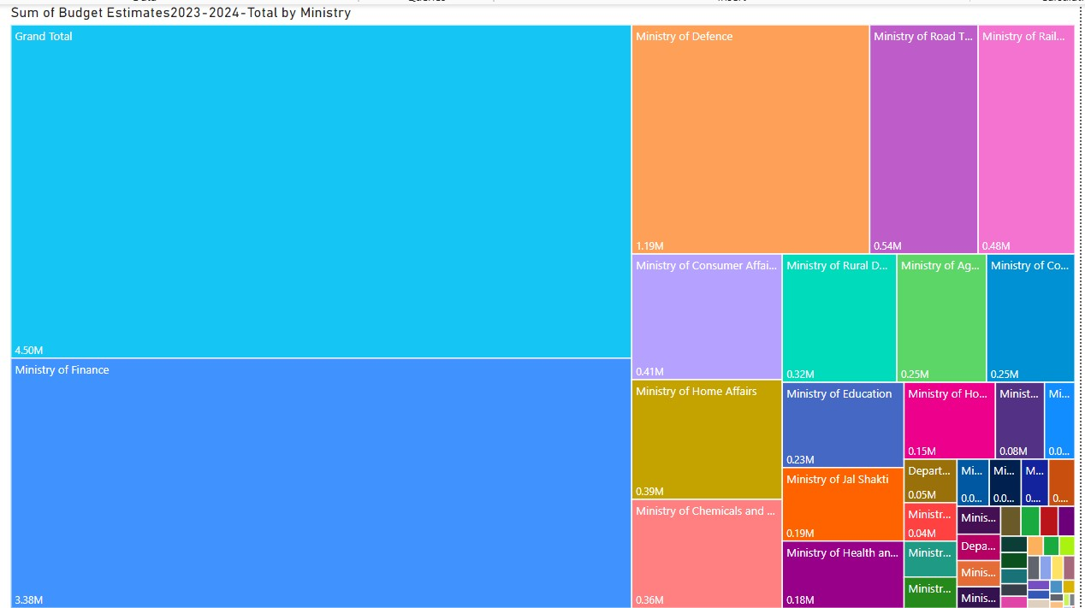
Collaboration of departments.
The tree map is used to see the contribution of the field .
The total value of all departments is 4.50M .
The ministry of finance is the highest among all with value of 3.38M .
Ministry of defence ,ministry of road transport and railways are among top budget estimations.
As the values decrease the box box area in treemap decrease the small boxes shows lesser contribution.

Slide 8
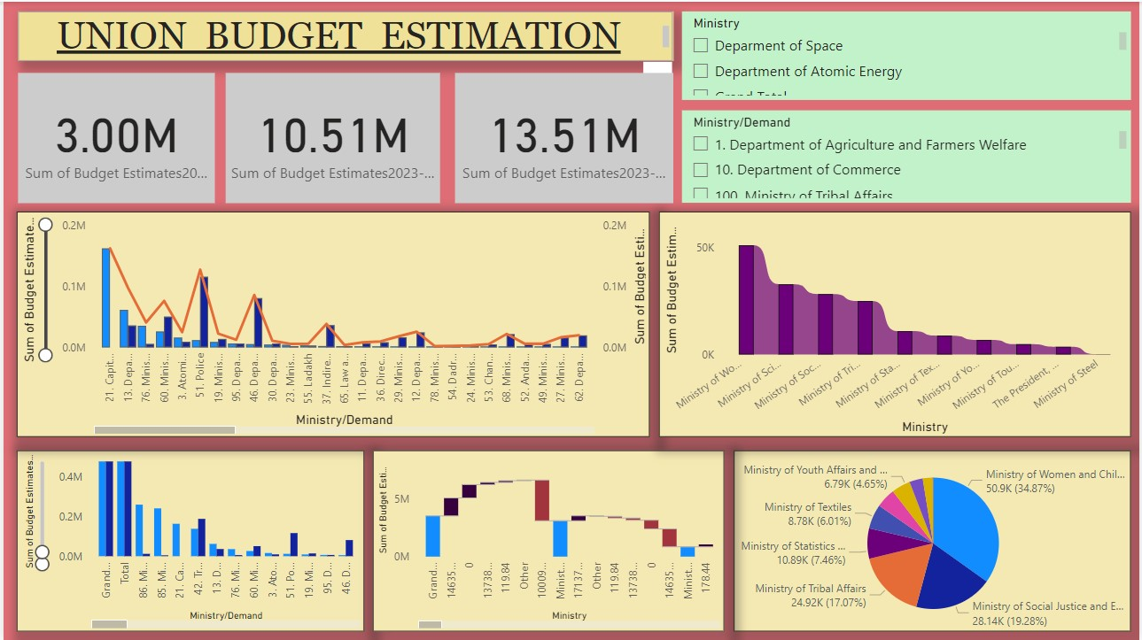
DASHBOARD (UNION BUDGET ANALYSIS) -----------------------------------------------------

Slide 9
INSIGHTS
There are total of 56 departments and the highest record is from DEFANCE SERVICES.The top three departments are defence services , food and public distributions , agriculture and farmers welfare .
Here we can observe that the ministry of road and transportation capital is more as compare to there revenue .The departments like police and health-care generates more revenue as per there capital.
The approximately 38 % of total budget is from ministry of women and child development.ministry of women and child development , ministry of social justice and empowerment and ministry of tribal affairs are the top three budget allocations.
The highest value to be taken is 50k and which is from women and child department .Ministry of steel has the lowest total sum in ministry .
The total value of all departments is 4.50M .The ministry of finance is the highest among all with value of 3.38M .Ministry of defence ,ministry of road transport and railways are among top budget estimations.

Slide 10
THANK YOU
----------------------

